Slide 1
Forecast Depression Level and Risk of Suicide
Team: QWQ
Group members: Amber Wang, Caroline Xu, Zimo Wu, Wanqing Li
Mentors: Farnoosh & Shilpa

Slide 2
Content
Introduction
Method
Result
Conclusion & Discussion

Slide 3
Content
Introduction
Method
Result
Conclusion & Discussion

Slide 4
Introduction - Why this topic?
Depression is a common illness worldwide which can lead to suicide
By WHO 2021, over 700 000 die due to suicide, suicide is the 4th leading cause of death in 15-29-year-olds
People experiencing depression tend to express their feelings on social networks
Depression
Suicide
Social Media
forecasting the depression level and risk of suicide through analysing social media posts

Slide 5

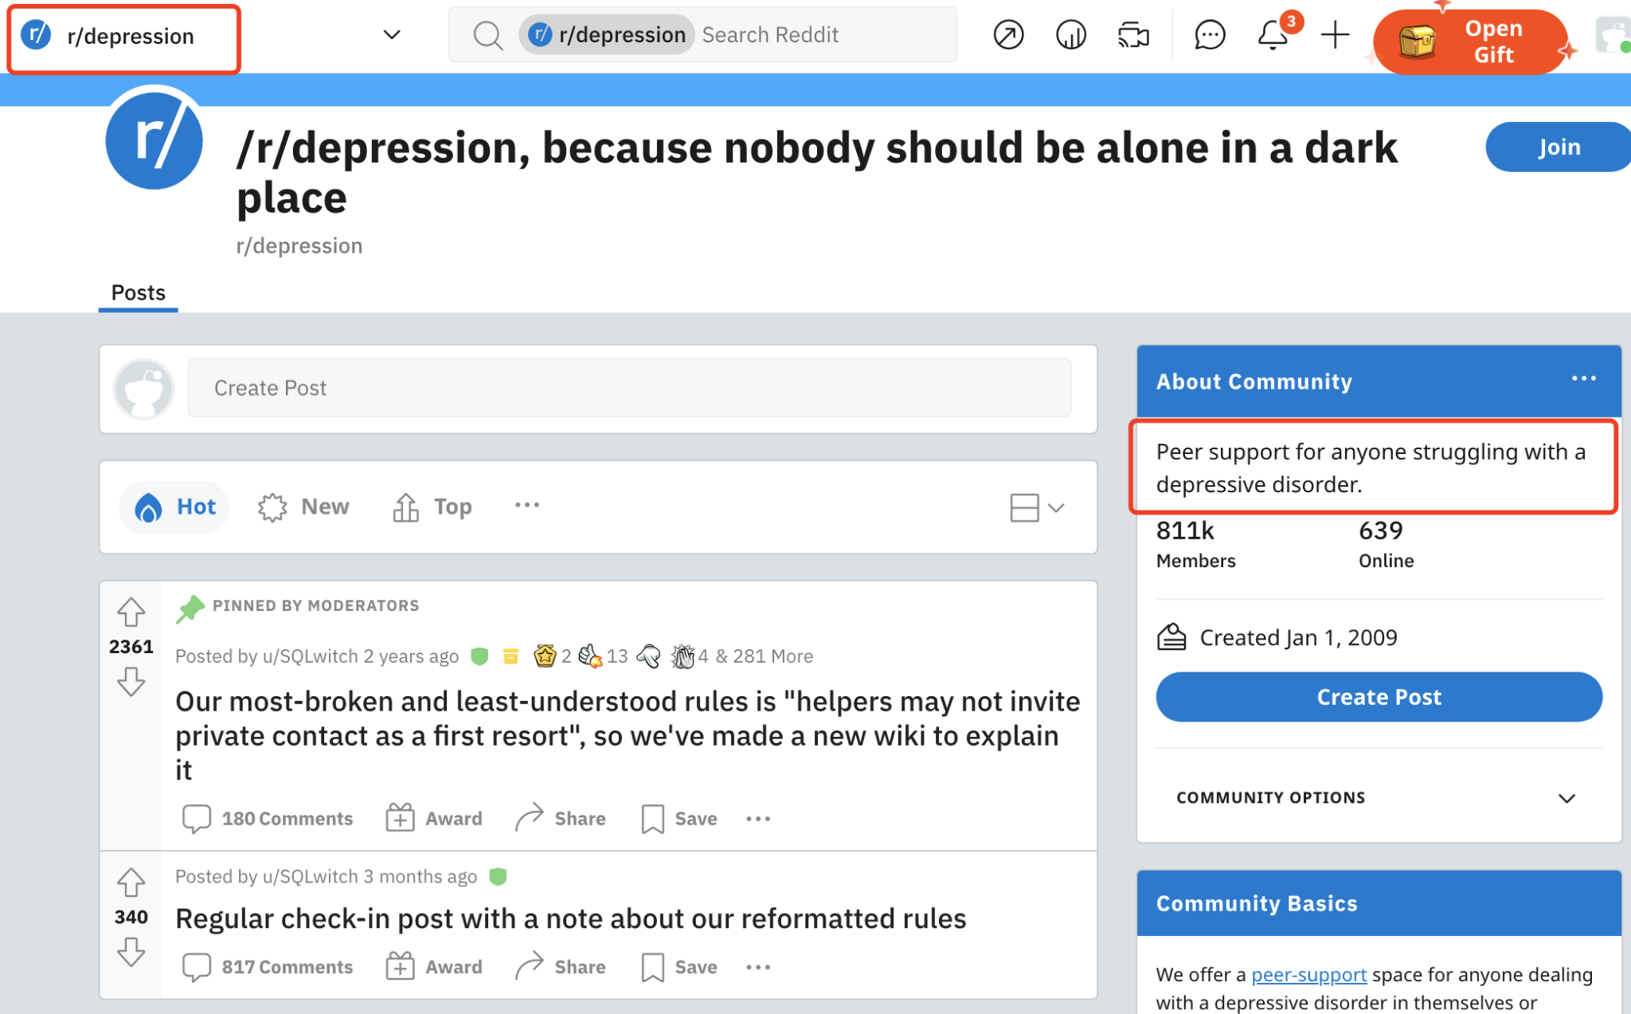
Introduction - Dataset
500 Redditors’ Posts with 5-label Depression Classification, postes are from

Slide 6
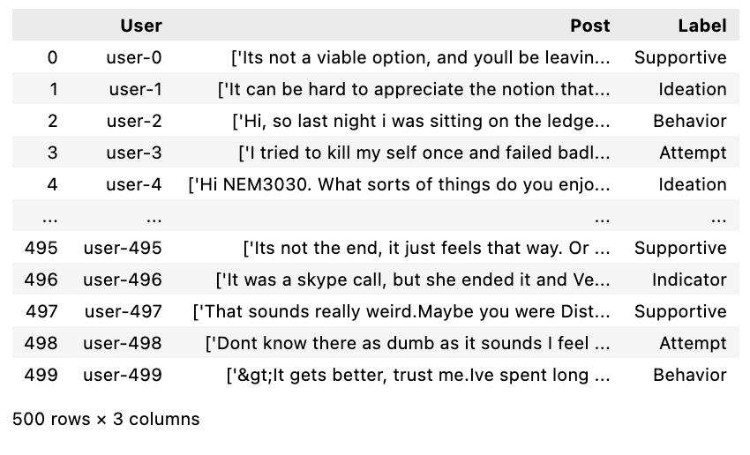
Introduction - Dataset
A list of posts sent by a particular user
User-Index, from 0 to 499, refer to users have discussed suicide
Labels developed manually by exports following the guidelines outlined in Columbia Suicide Severity Rating Scale (C-SSRS)

Slide 7
Introduction - Labels
C-SSRS-based 5-label Classification
 | Supportive | participating in discussion but not showing any sign of being at risk in the past or present
 | Indicator | supportive but use at-risk language while sharing personal experience
 | Ideation | has thoughts of suicide
 | Behavior | having historical self-harm or planning to commit suicide
 | Attempt | having deliberate action that may result in intentional death, like writing a public “good bye” note

Slide 8
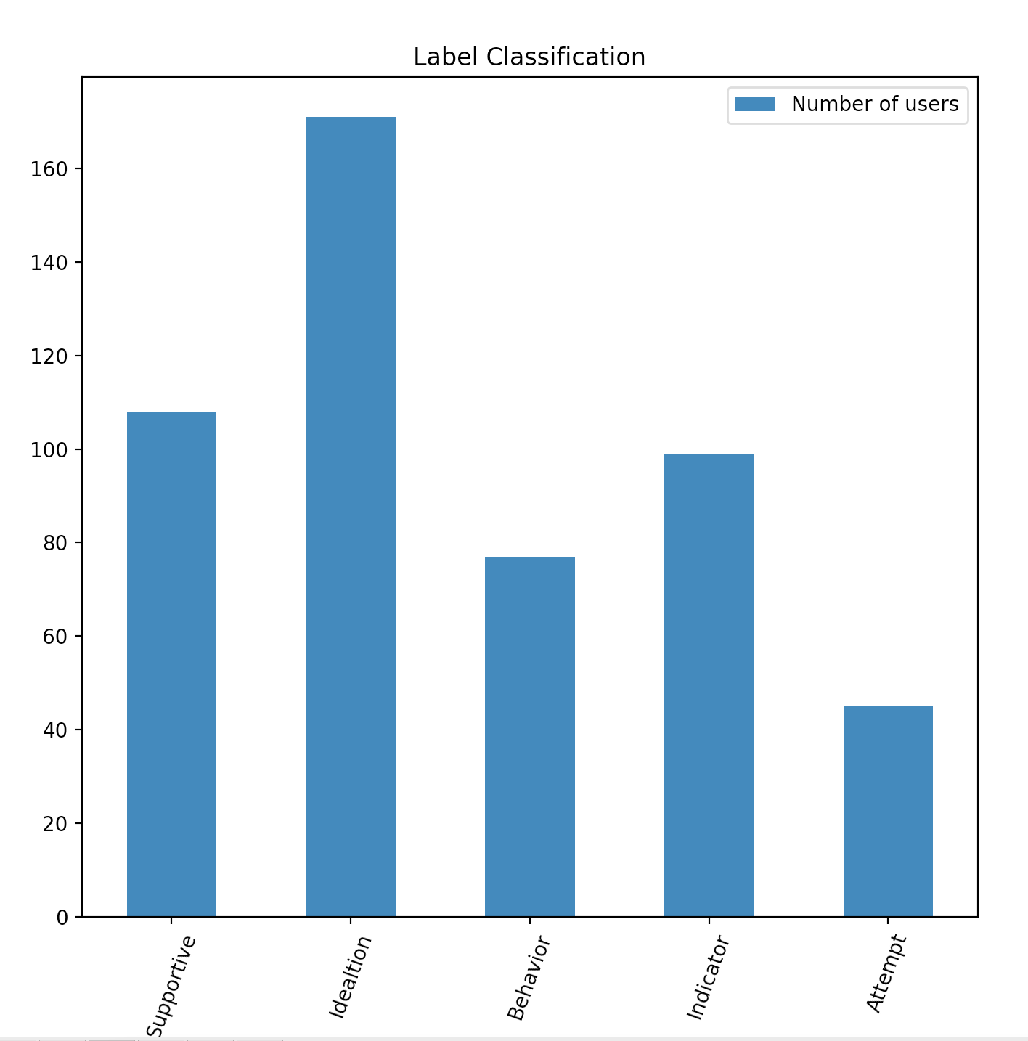
Introduction - Description of Dataset

Slide 9
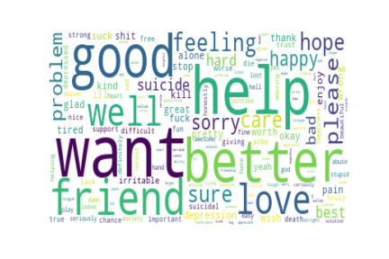
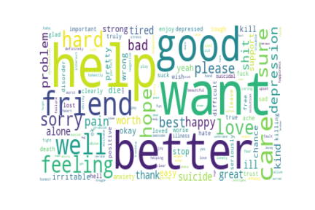

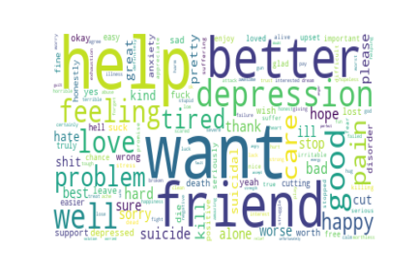
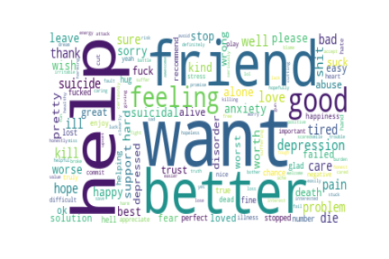
Introduction - Description of Dataset
Supportive
Indicator
Ideation
Behavior
Attempt

Slide 10
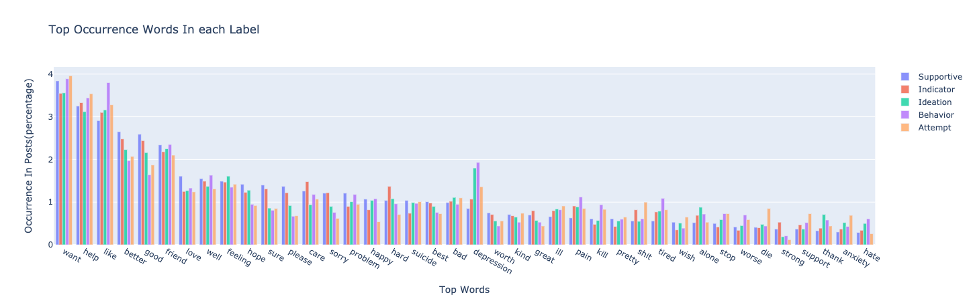
Introduction - Description of Dataset

Slide 11
Introduction - Description of Dataset

Slide 12
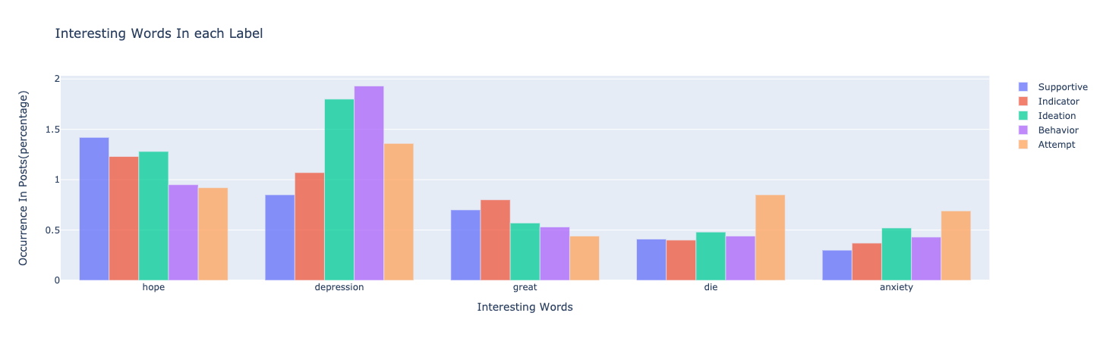
Introduction - Description of Dataset

Slide 13
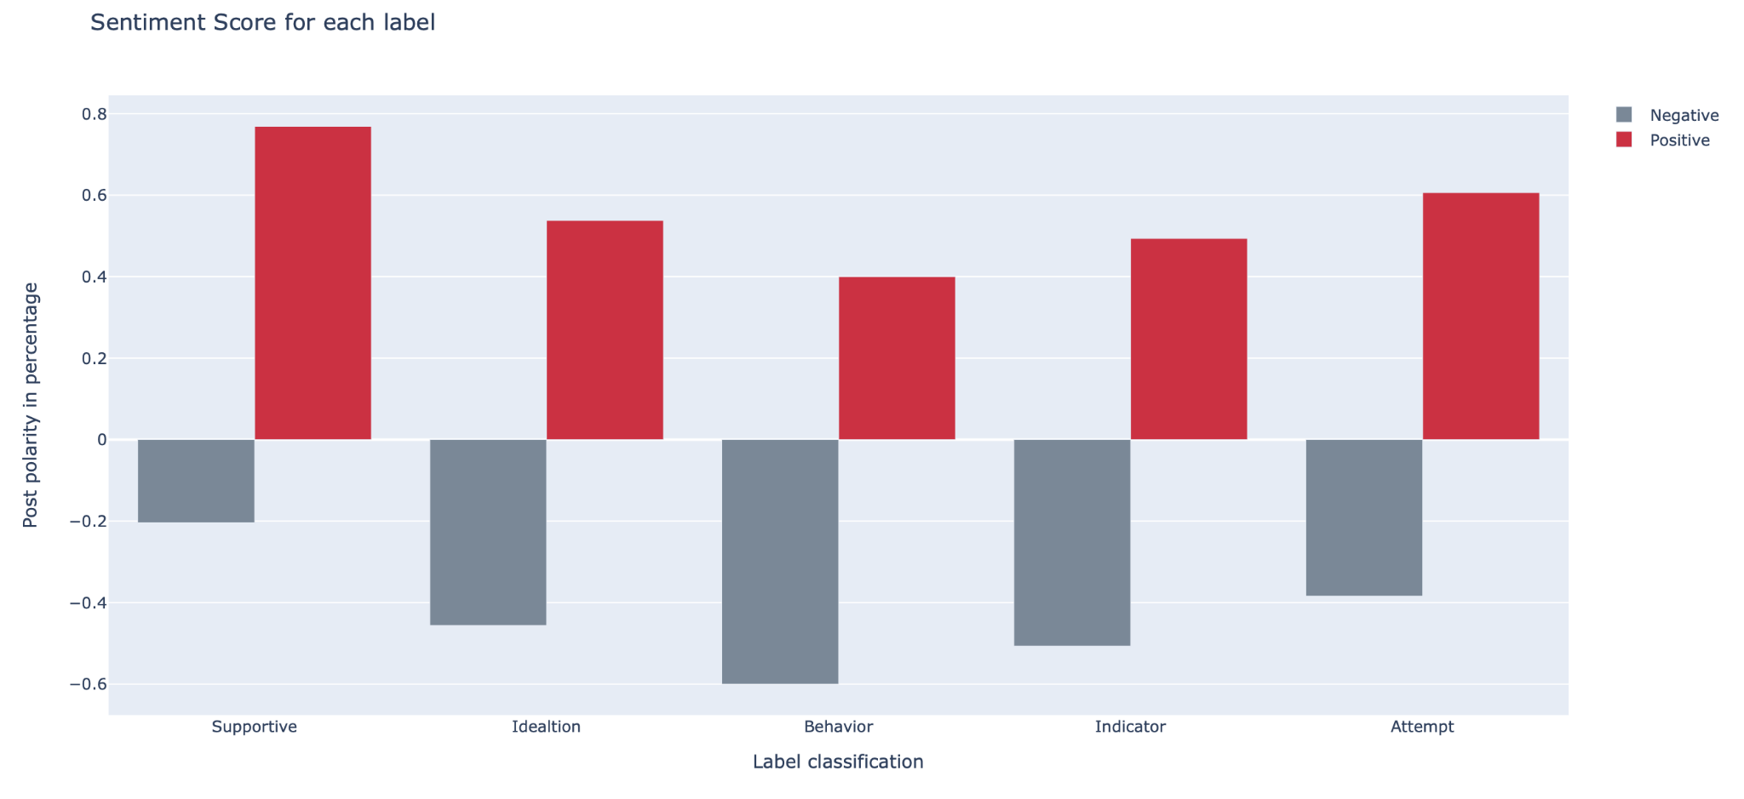
Introduction - Description of Dataset

Slide 14
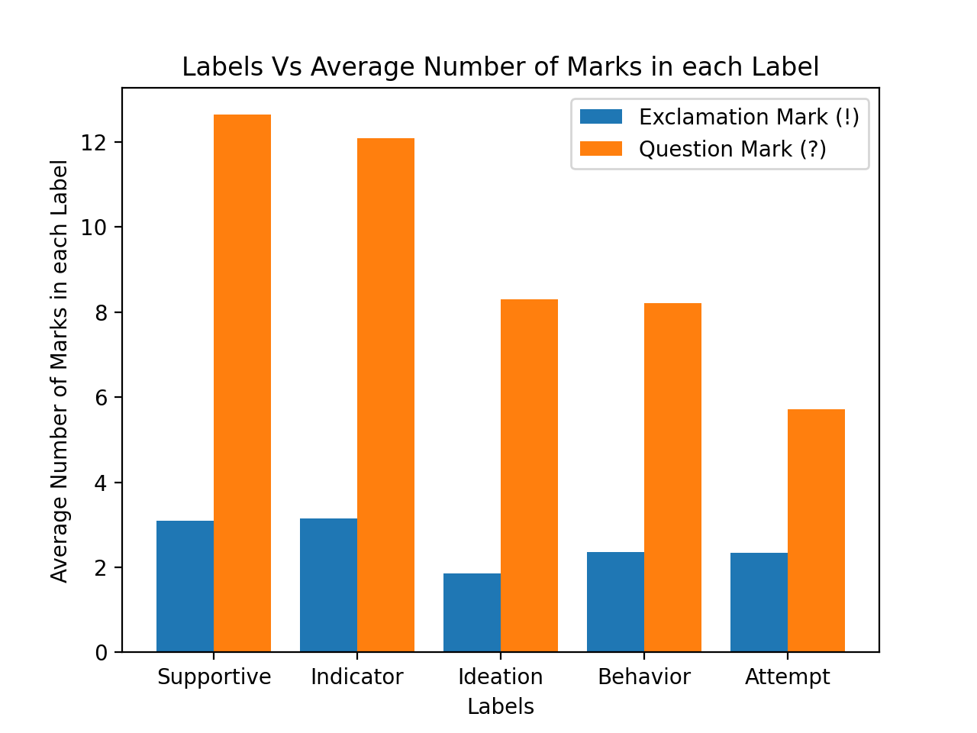
Introduction - Description of Dataset

Slide 15
Content
Introduction
Method
Result
Conclusion & Discussion

Slide 16
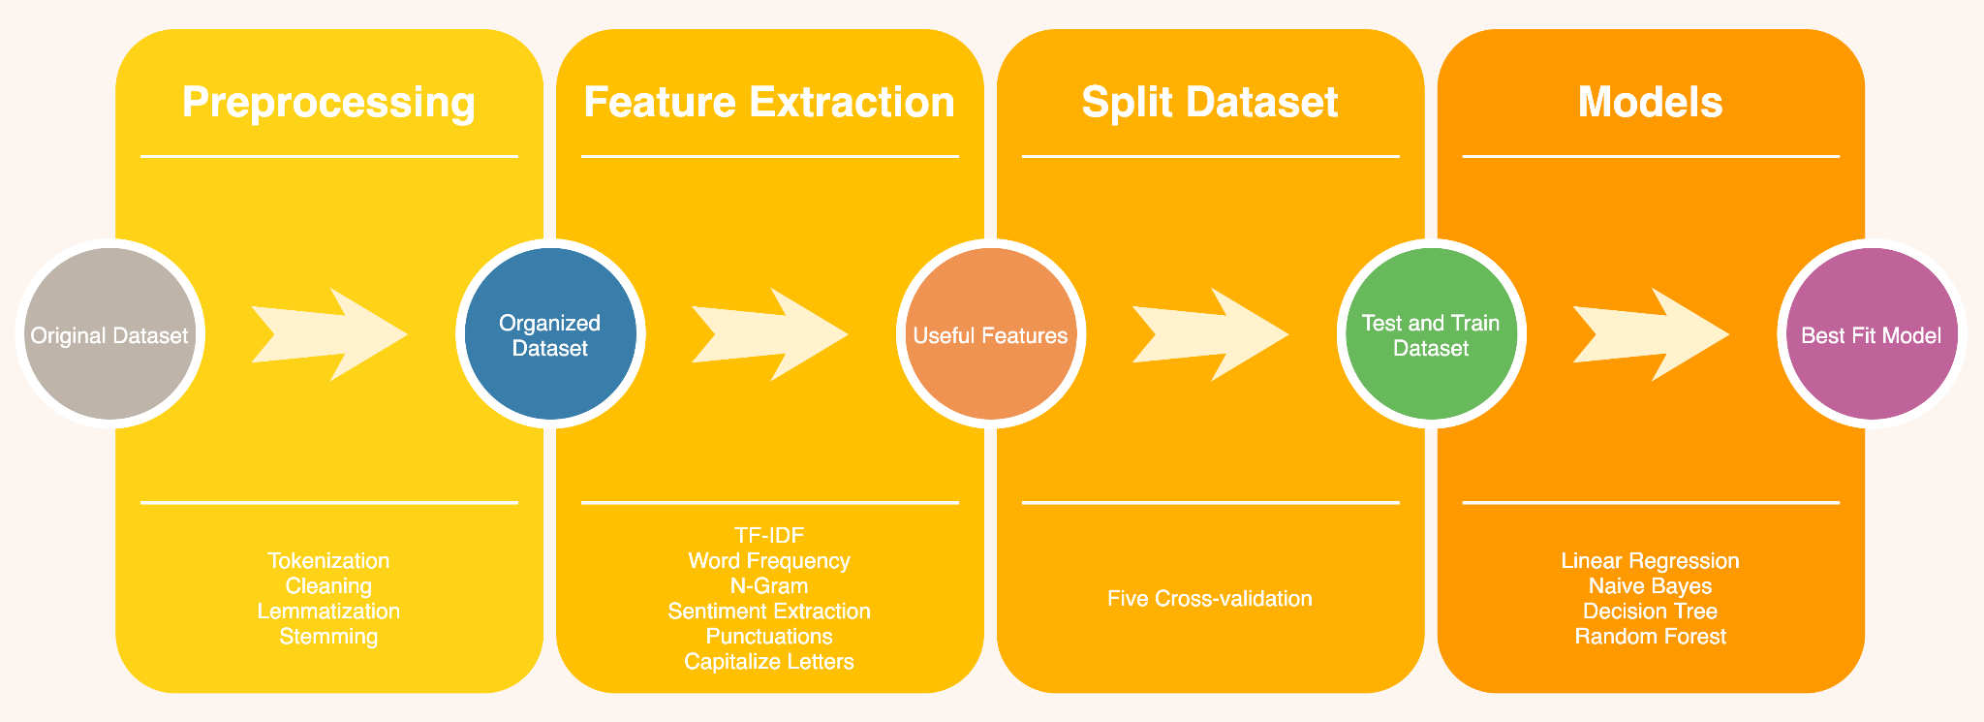
Method - Machine Learning

Slide 17
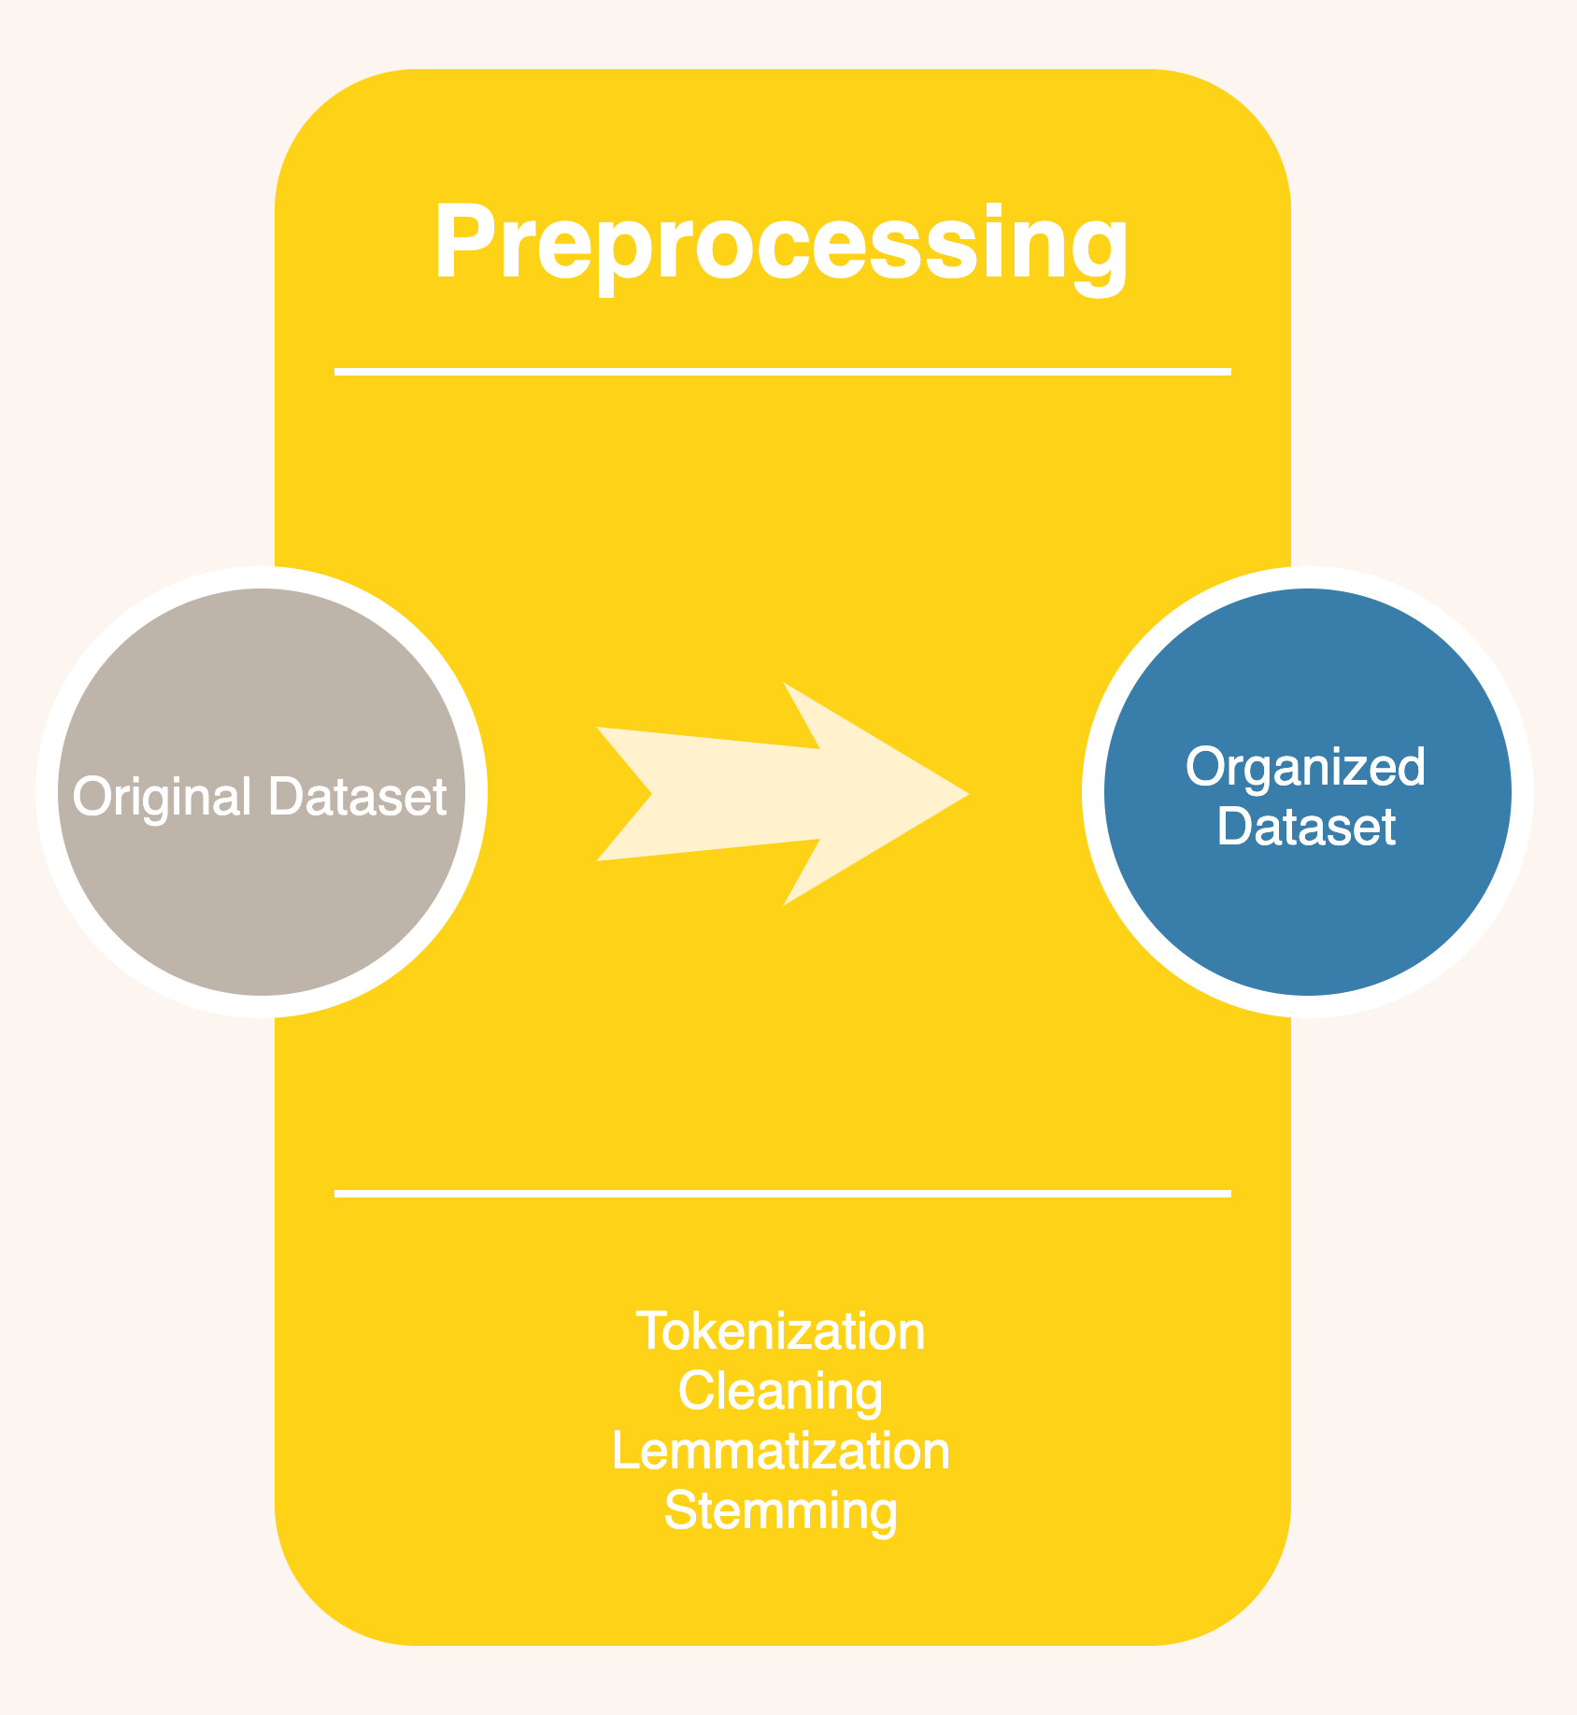
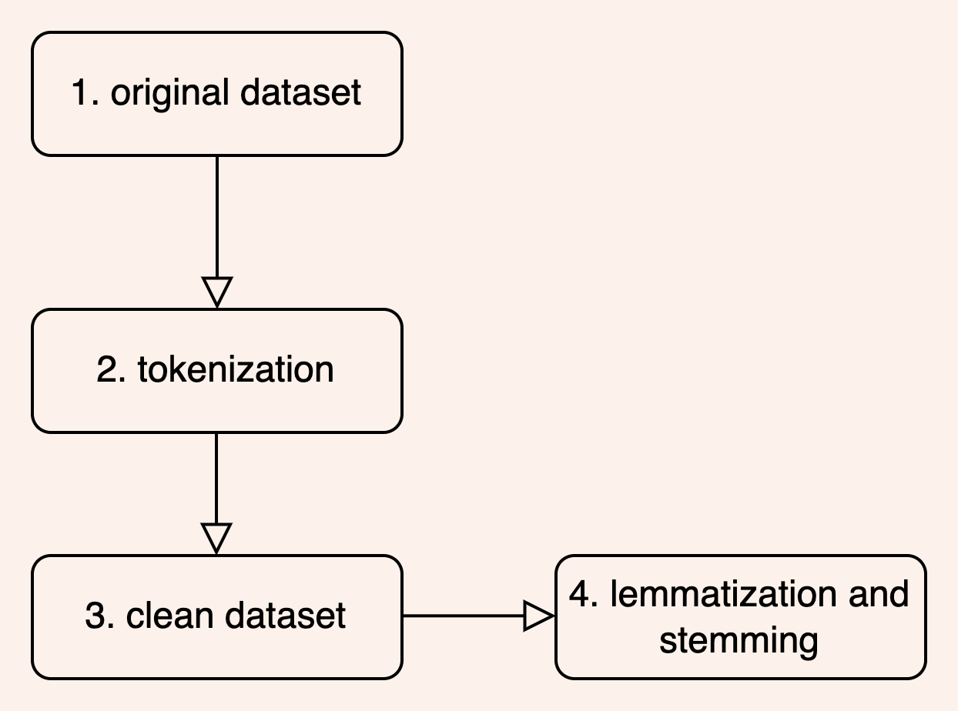
Method - Preprocessing the Dataset

Slide 18
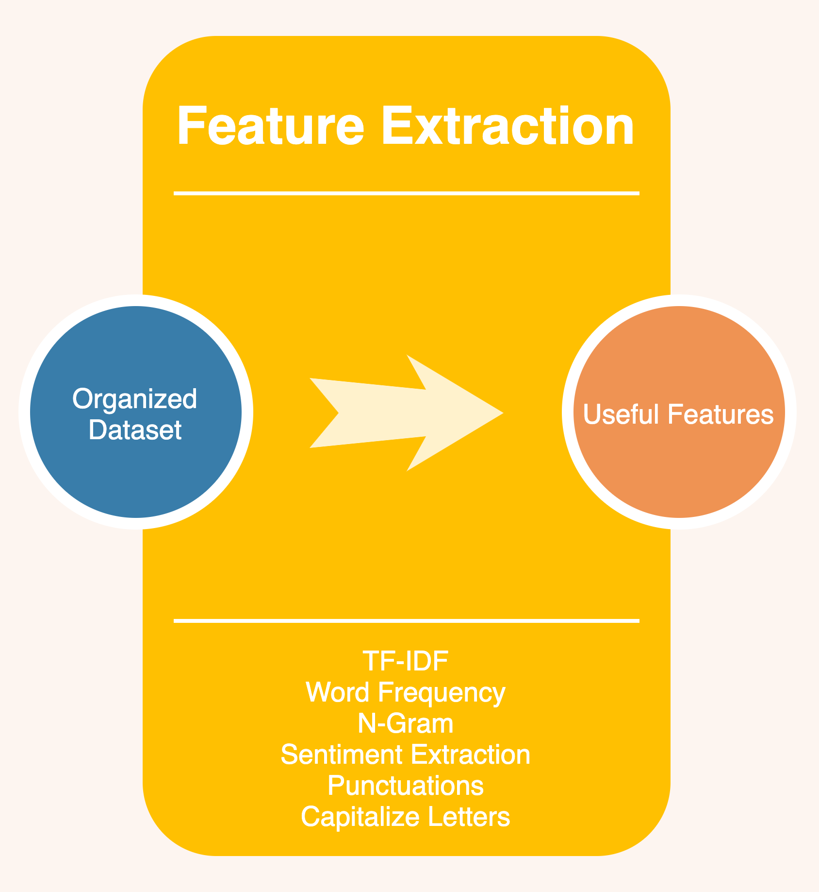
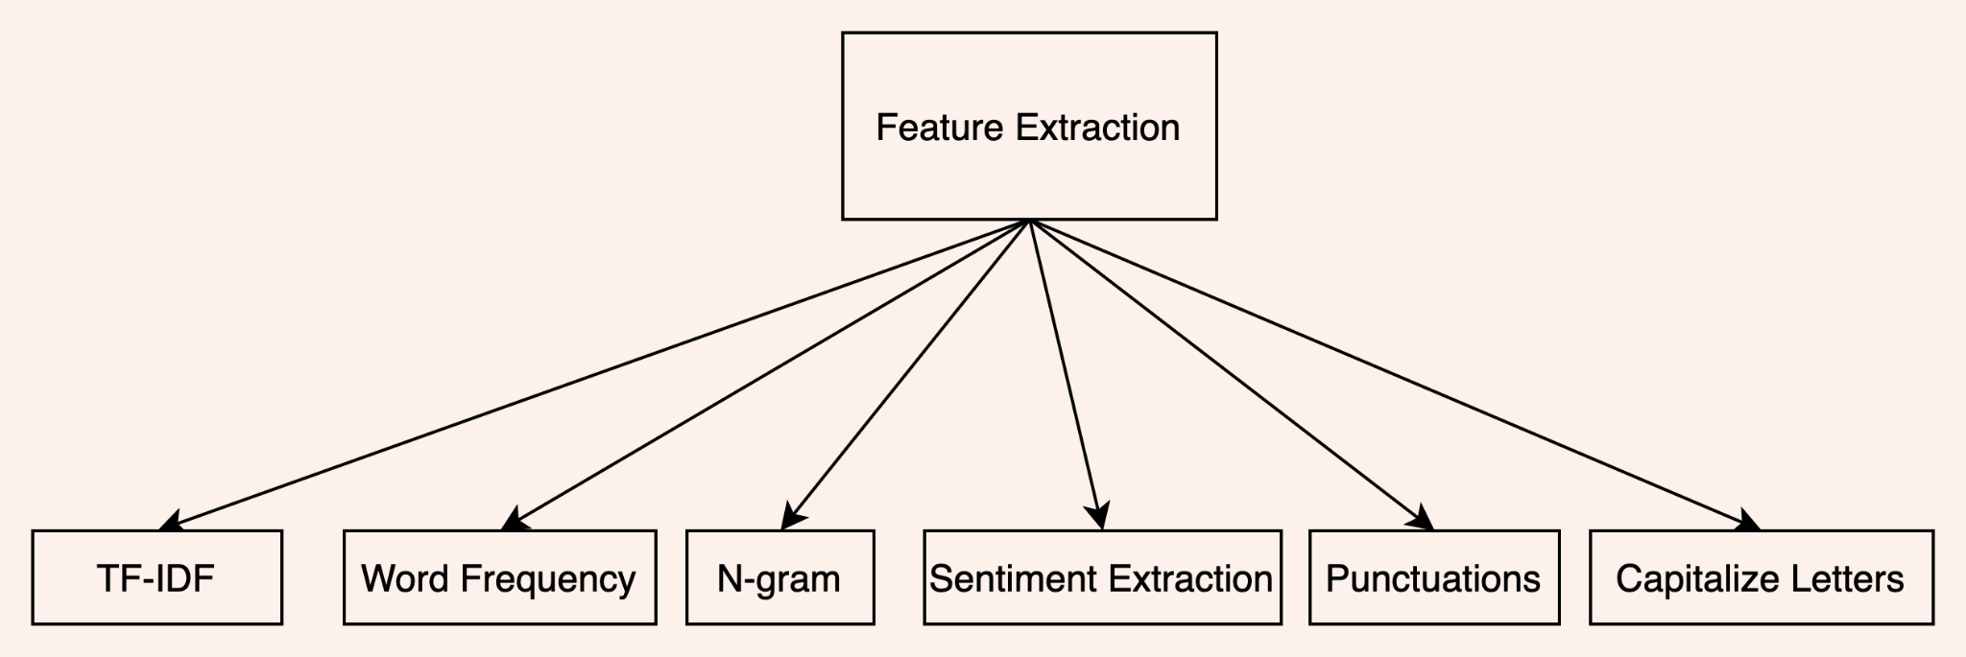
Method - Feature Extraction

Slide 19
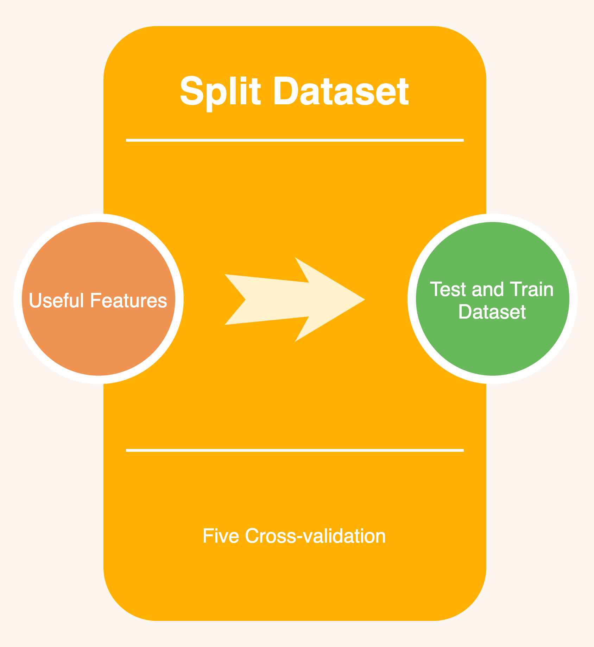
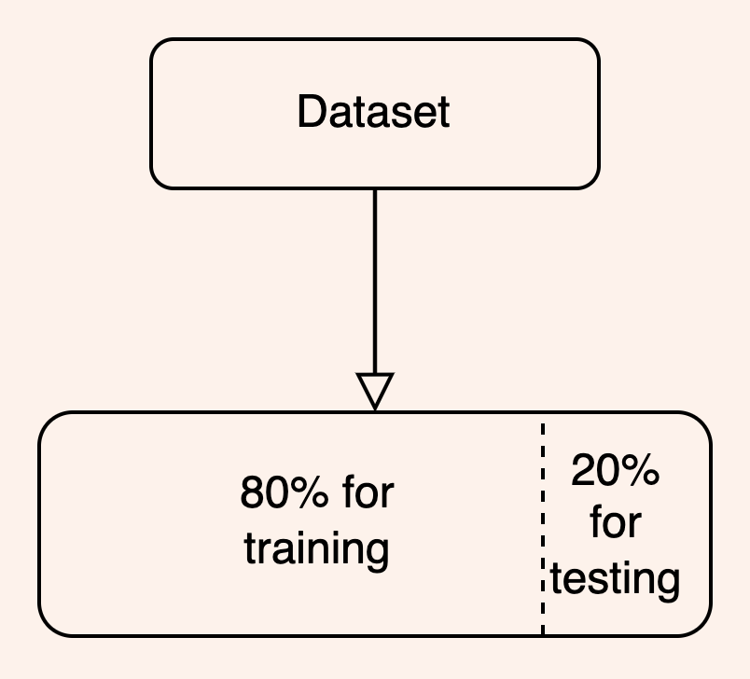
Method - Split Dataset

Slide 20
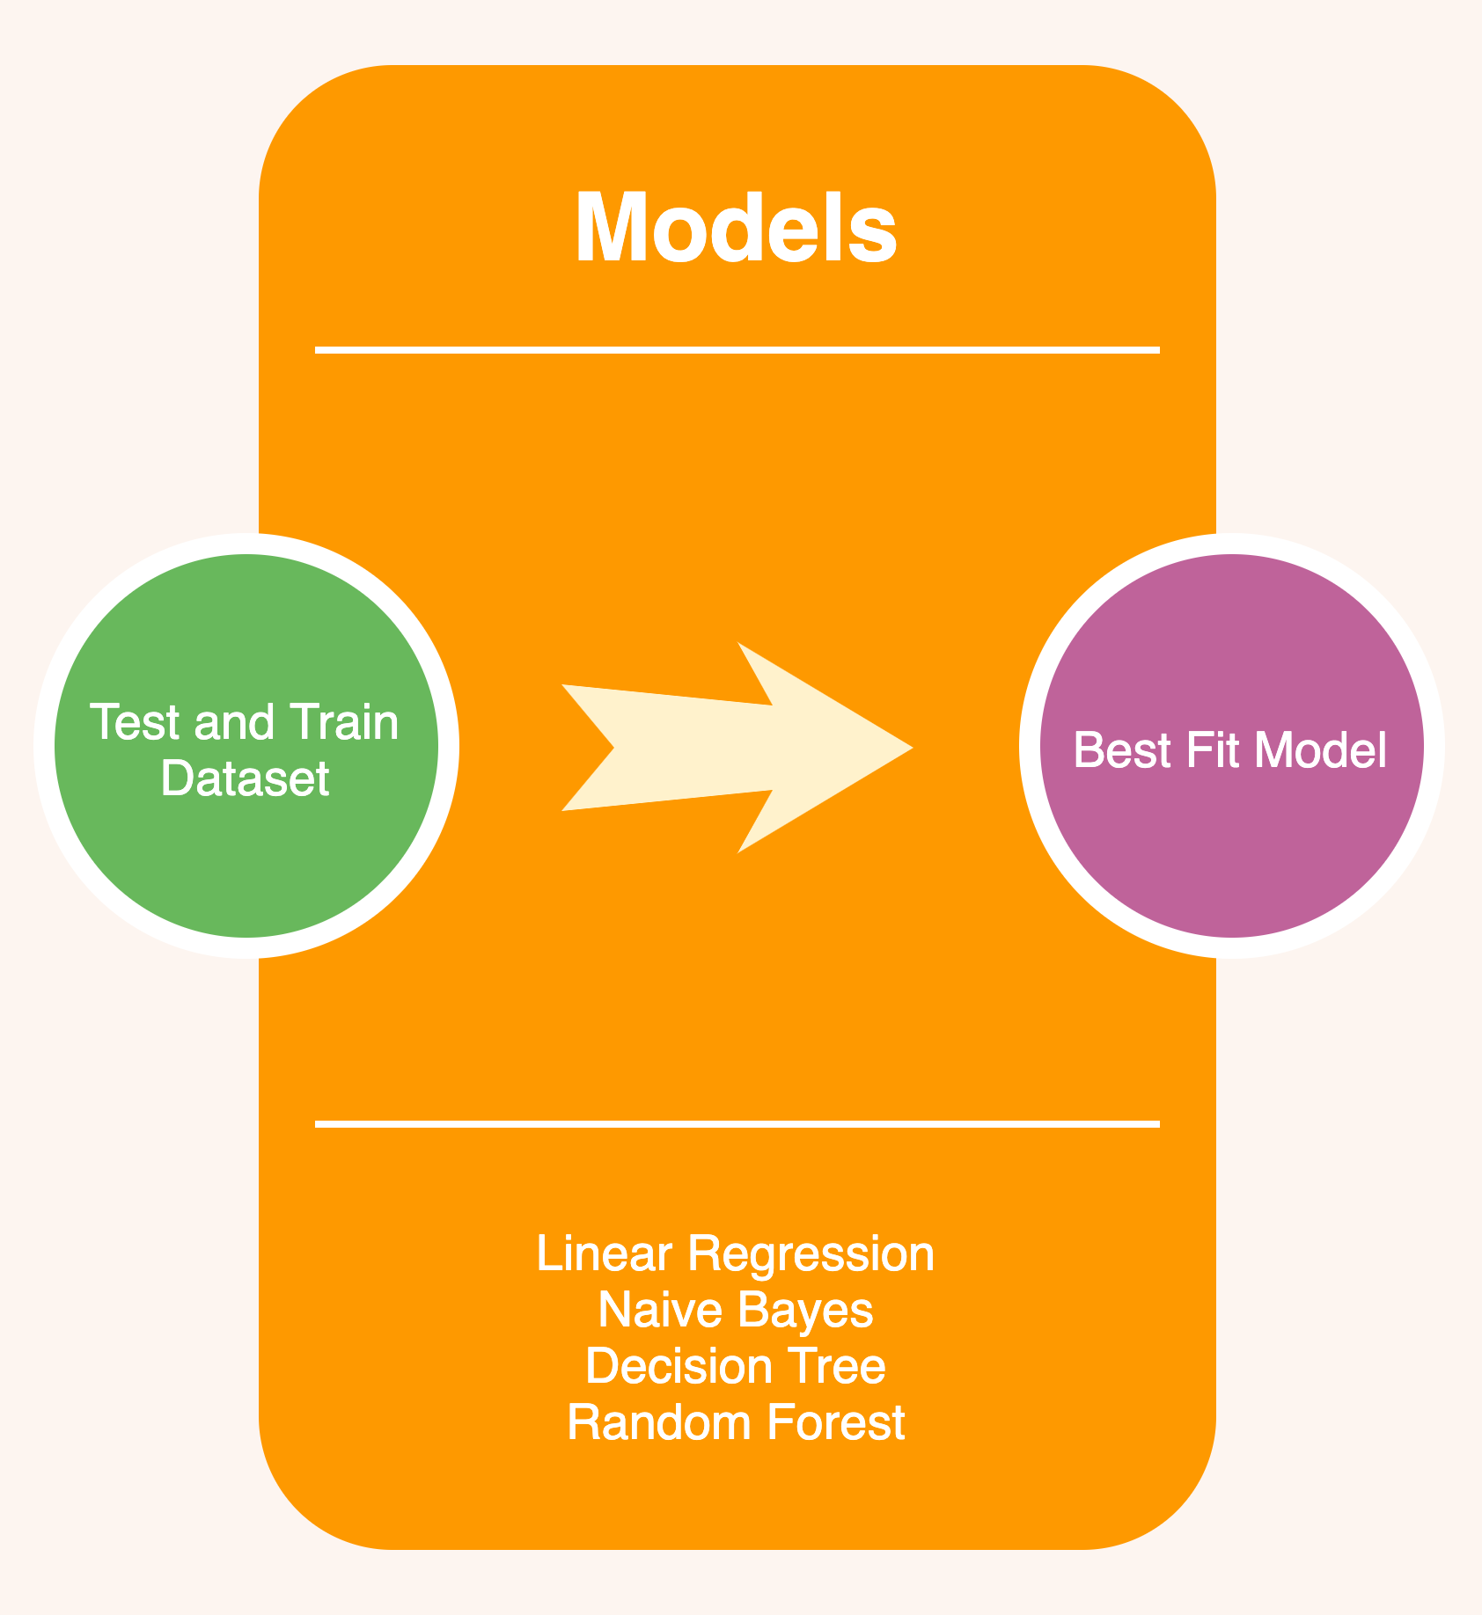
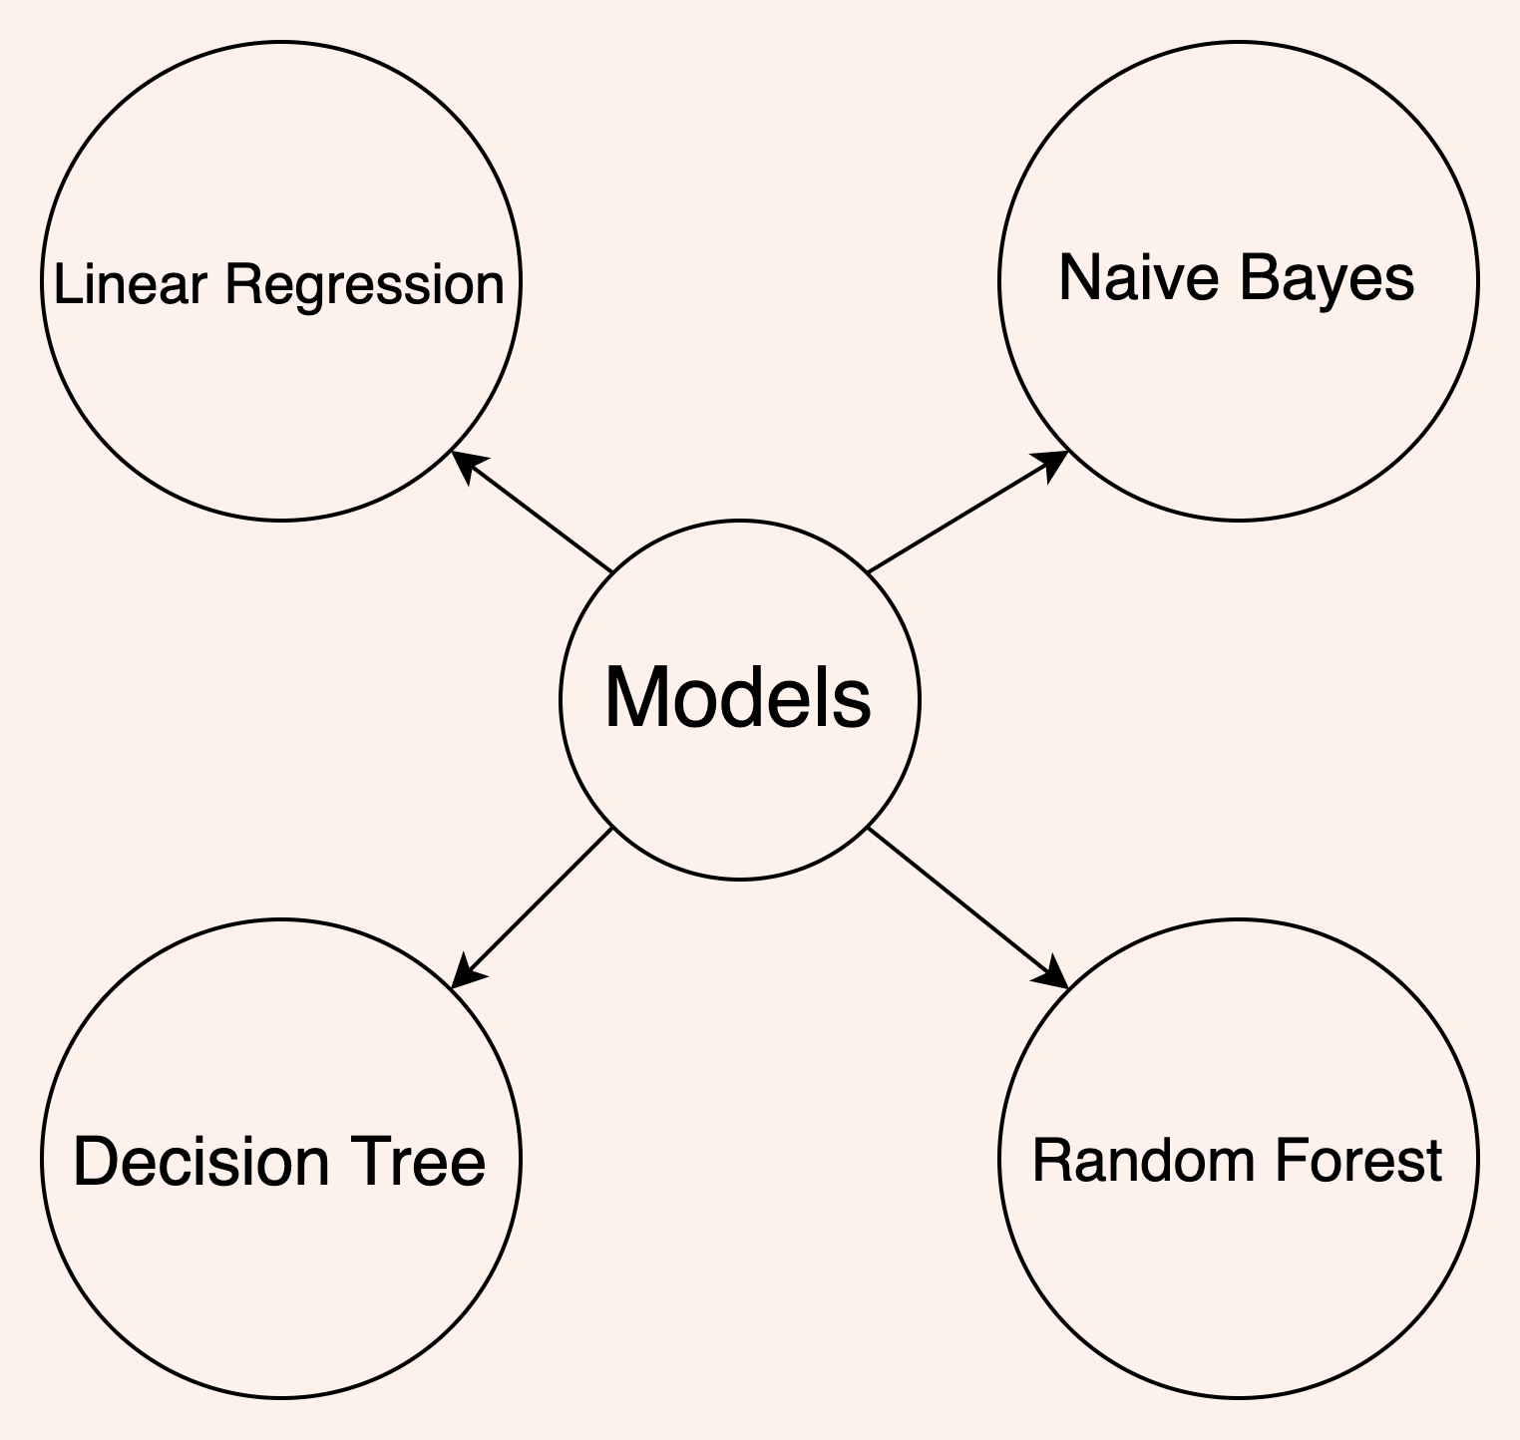
Method - Different Models

Slide 21
Method - Machine Learning
Preprocessing the dataset: Tokenization -> Clean Data -> Lemmatization and Stemming
Feature Extraction:
TF-IDF (term frequency-inverse document frequency)
Count Word Frequency
n-gram model
Sentiment Extraction (polarity of sentences)
Punctuations
Capitalize letters
Split dataset: 80% training, 20% testing
Algorithm to choose model:
Linear Regression
Naive Bayes
Decision Tree
Random Forest

Slide 22
Content
Introduction
Method
Result
Conclusion & Discussion

Slide 23
Results
00
01
02
03
Dummy classifier score:
PCA
Max feature
Grid search
Reduce dimension to 300
For random forest and decision tree
Set to 20, 50, 100 in our model
0.23

Slide 24
Table 1: using PCA reduce dimension to 500, no max feature, no grid search CV
Model Name | Accuracy
Linear regression | 0.10
Naive Bayes | 0.15
Random Forest | 0.31
Decision Tree | 0.25

Slide 25
Table 2: max feature=20, No PCA, random forest and decision tree used grid search CV
Model Name | Macro F1 Score | Micro F1 Score | Weighted F1 score | Best parameter
Linear regression(no grid) | 0.09 | 0.14 | 0.09 | /
Naive Bayes(no grid) | 0.20 | 0.28 | 0.26 | /
Random Forest | 0.21 | 0.32 | 0.27 | ‘criterion': 'gini', 'max_depth': 30, 'n_estimators': 38
Decision Tree | 0.18 | 0.33 | 0.26 | 'criterion': 'entropy', 'max_leaf_nodes': 3, 'min_samples_split': 2

Slide 26
Table 3: max feature=50, No PCA, random forest and decision tree used grid search CV
Model Name | Macro F1 Score | Micro F1 Score | Weighted F1 score | Best parameter
Linear regression(no grid) | 0.11 | 0.15 | 0.13 | /
Naive Bayes(no grid) | 0.21 | 0.25 | 0.26 | /
Random Forest | 0.22 | 0.36 | 0.30 | 'criterion': 'gini', 'max_depth': 5, 'n_estimators': 17
Decision Tree | 0.19 | 0.33 | 0.25 | 'criterion': 'gini', 'max_leaf_nodes': 13, 'min_samples_split': 2

Slide 27
Table 4: max feature=100, No PCA, random forest and decision tree used grid search CV
Model Name | Macro F1 Score | Micro F1 Score | Weighted F1 score | Best parameter
Linear regression(no grid) | 0.13 | 0.19 | 0.18 | /
Naive Bayes(no grid) | 0.21 | 0.24 | 0.25 | /
Random Forest | 0.24 | 0.37 | 0.30 | 'criterion': 'entropy', 'max_depth': 55, 'n_estimators': 31
Decision Tree | 0.22 | 0.33 | 0.28 | 'criterion': 'gini', 'max_leaf_nodes': 4, 'min_samples_split': 2

Slide 28
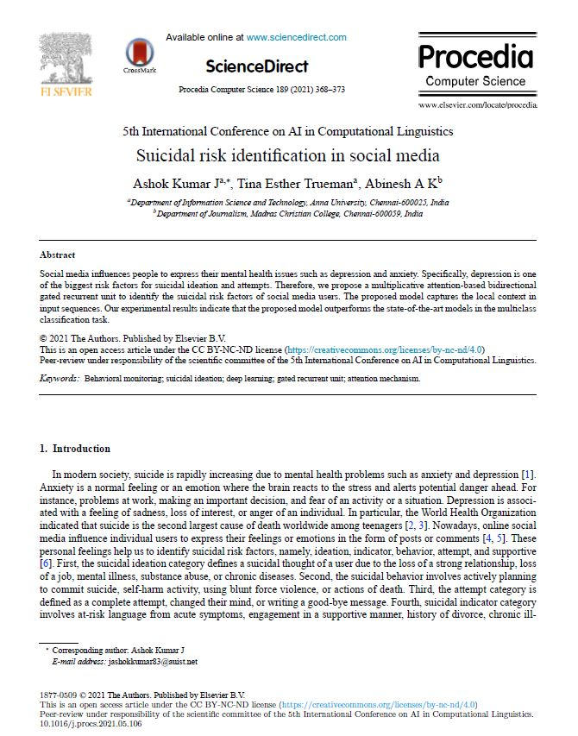
Results

Slide 29
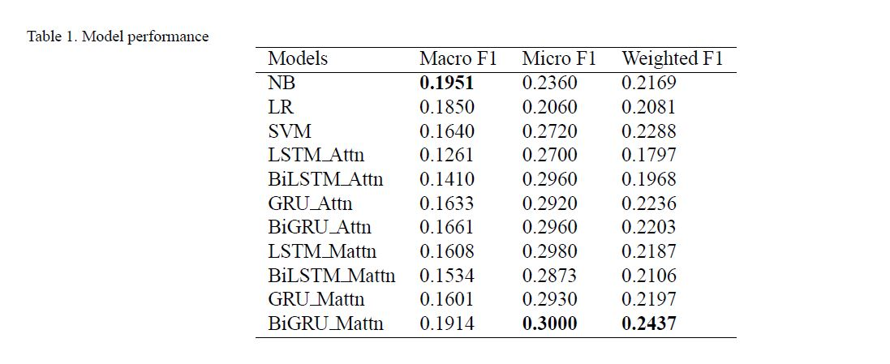
Results

Slide 30
Content
Introduction
Method
Result
Conclusion

Slide 31
Conclusion - Accomplishment
1. Data preprocessing
Select the dataset, clean the dataset, stemming & lemmatization
2. Feature extraction
TFIDF, N-gram, Sentiment, strong emotions
3. Train the 4 model
Split the data to train and test
4.Evaluate & Finalize model
Choose one model from 4 model

Slide 32
Conclusion - Blockers & Solutions
Reduce dimension
03
Condition
PCA
Max Feature
Accuracy
02
Condition
Initial evaluate method is wrong
Use F1 score and other methods
Feature
01
Condition
Not enough features
Brainstorm together

Slide 33
Conclusion - Experience
Educate
Explore
Engage
Execute
Learn knowledge and theories from school
Explore more information like coding on Internet
Engage in project,
Combine coding & knowledge together
Get a final model from machine learning

Slide 34
Conclusion - Future
Support diagnose
1. Increase awareness
2. Support doctor
User could test their posts by themselves, and get suggestion
Doctor could use this model to make more structured decision

Slide 35
Conclusion
Thank you!

Slide 36
Q&A
Any Question?

